Slide 1

University Institute of Engineering
DEPARTMENT OF COMPUTER SCIENCE & ENGINEERING
Bachelor of Engineering (Computer Science & Engineering)
Subject Name : SEARCH ENGINE OPTIMIZATION
Subject Code: 20CST-463
Topic: Lecture-1.1.2
Lecture- Basics Of SEO
By : Sourabh Budhiraja
DISCOVER . LEARN . EMPOWER

Slide 2
Syllabus
UNIT-1: Introduction to Search Engine Optimization
CHAPTER-1: Introduction to Search Engine Optimization:
Understanding of search engines, Basics of SEO, Keyword Research, On-Page Optimization, Technical SEO.
CHAPTER-2: Content Creation and SEO tools:
Content Creation for SEO, SEO Analytics, SEO Tools, Local SEO, SEO Ethics and Future Trends.

Slide 3
CONTENTS
What is Search Engine Optimization?
Why is SEO important?
Basic principles in the working of a Search Engine
Do all search engines work on the same principle?
Why is SEO important for your business?
Types of SEO

Slide 4
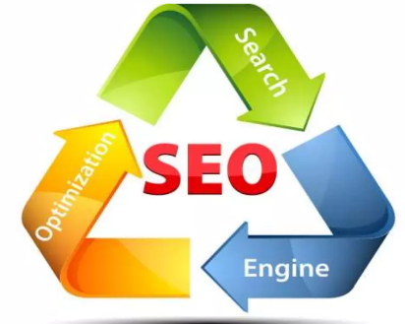
What is Search Engine Optimization?
SEO, which stands for Search Engine Optimization, is a crucial aspect of digital marketing and online visibility. It involves optimizing a website or online content to improve its visibility and ranking in search engine results pages (SERPs).

Slide 5
Why is SEO important?
To help gain more visitors: majority of users click on only the top 4-5 web pages appearing in search results, so it’s very important for a website to appear in the top results of a search engine.
Important for social promotion of a website: if a website appears in top results of a search engine such as Google, Bing, etc. then it gains instant popularity and to some extent trust of a user.
It plays an important role in improving the business of a commercial site: if two websites are selling the same product, for example, both Myntra and Koovs focus on selling fashion clothing, then the site having a better position in the search result of a search engine has chances of getting more users as compared to the other.
Improving user experience: SEO doesn’t focus only on improving search results but also on improving the user experience and usability of a website so that a website is more appealing to a user.

Slide 6
Basic principles in the working of a Search Engine
Crawling: Process of fetching all the web pages linked to a website. This task is performed by a software, called a crawler or a spider (or Googlebot, in the case of Google).
Indexing: Process of creating index for all the fetched web pages and keeping them into a giant database from where it can later be retrieved. Essentially, the process of indexing is identifying the words and expressions that best describe the page and assigning the page to particular keywords.
Processing: When a search request comes, the search engine processes it, i.e. it compares the search string in the search request with the indexed pages in the database.
Calculating Relevancy: It is likely that more than one page contains the search string, so the search engine starts calculating the relevancy of each of the pages in its index to the search string.
Retrieving Results: The last step in search engine activities is retrieving the best matched results. Basically, it is nothing more than simply displaying them in the browser.

Slide 7
Do all search engines work on the same principle?
Although the basic principle of operation of most of the search engines is the same there are minor differences between them which lead to major changes in their results. For example, for search engines like Yahoo and Bing, on-page keyword factors are of primary importance, while for Google, links and hyperlinks are more important.
Also, for Google, rankings of a website depend largely on their primitiveness i.e. how old a website is as compared to Yahoo which gives less or no preference to the primitiveness of the website and hence to improve the ranking of a website in different search engine, slightly different procedure needs to be followed.

Slide 8
Why is SEO important for your business?
SEO is one of the most powerful digital marketing strategies you can deploy to improve sales, build credibility, increase brand awareness, and gain a leg up on your competitors.
A solid SEO foundation not only attracts new customers but also lets you deepen your business’s relationship with those customers because of the trust you establish with them.

Slide 9
Types of SEO
There are two types of SEO practices that are used for this purpose:
On-page SEO
Off-Page SEO

Slide 10
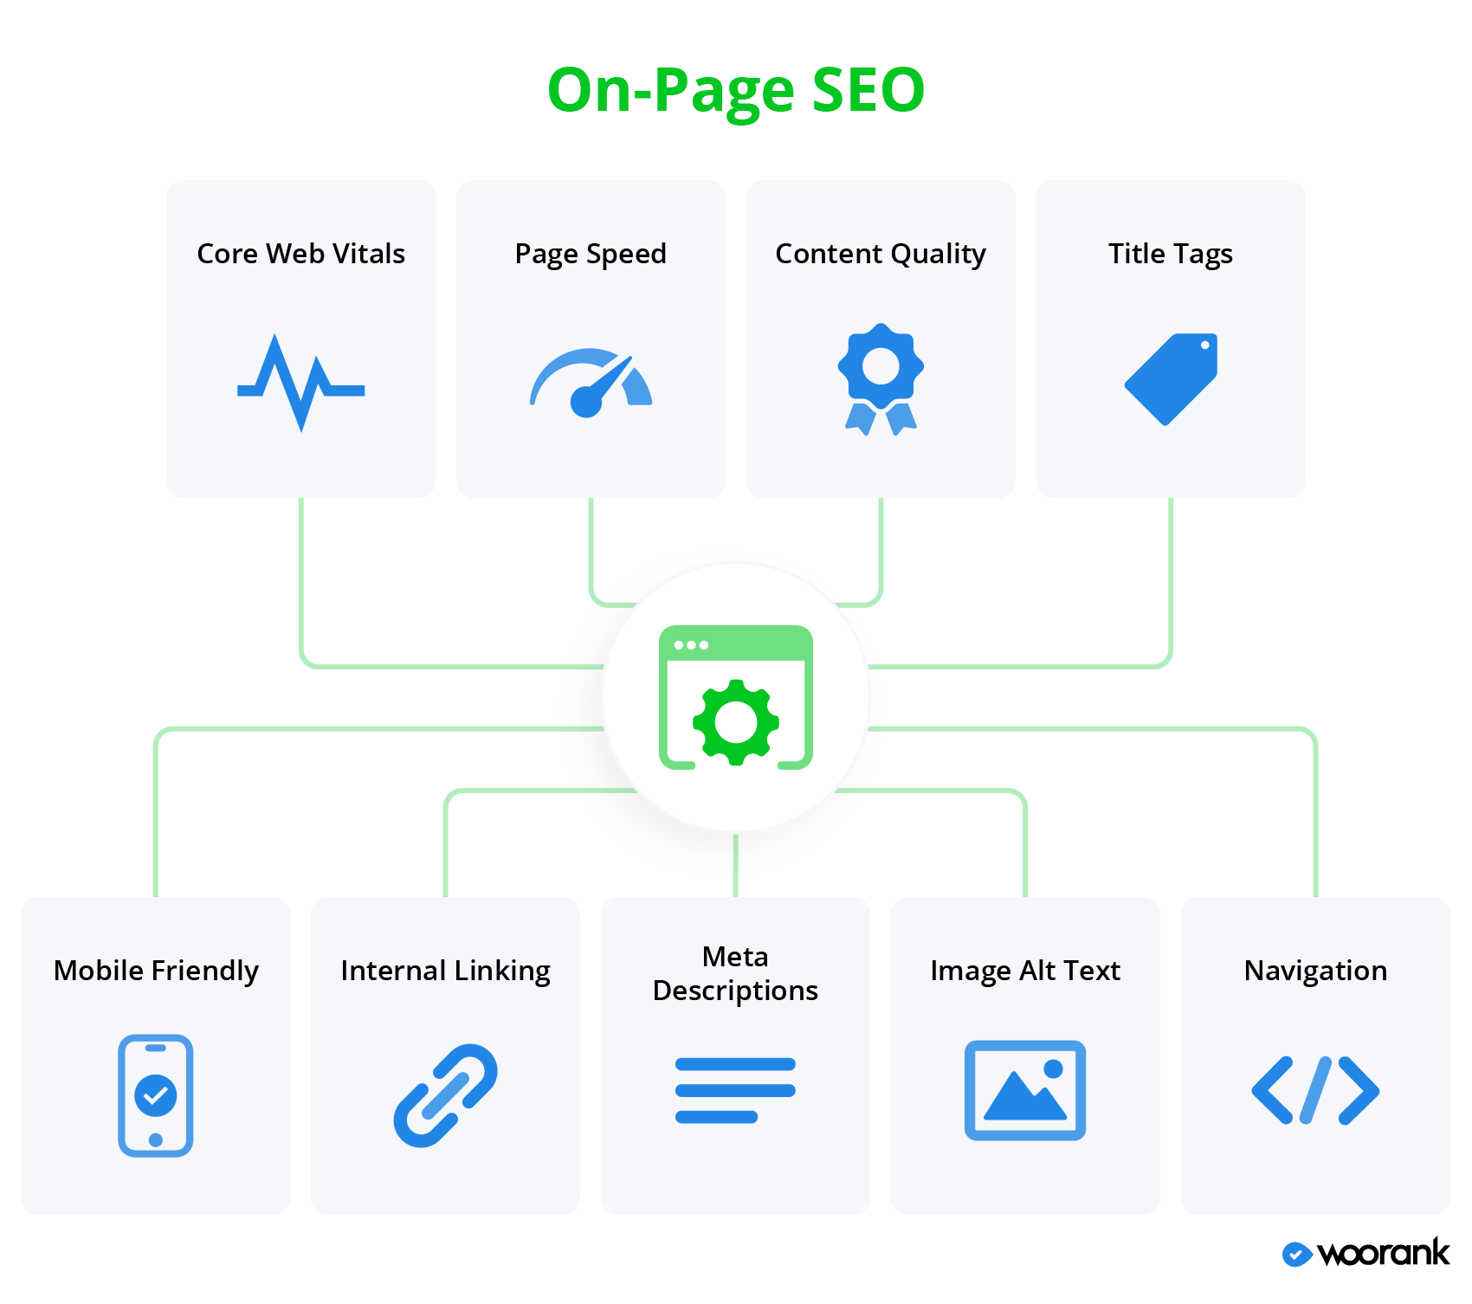
Types of SEO(Cont.)
On-page SEO
Anything that is done inside the website is a part of On-page SEO. It’s all about Keyword Optimization.

Slide 11
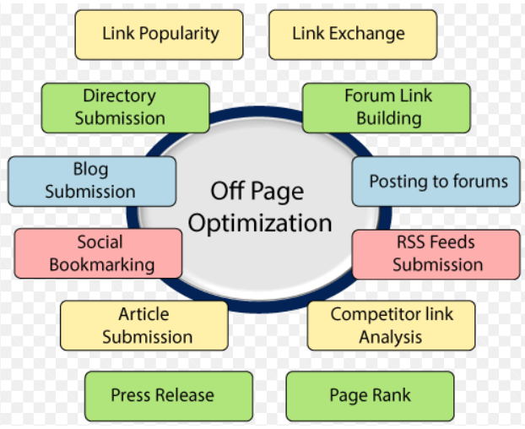
Types of SEO (Cont.)
Off-page SEO
Off-page SEO is generally regulated by links. Pages with the similar type of contents are linked together.

Slide 12
References
Books and Journals-
Eric Enge, Stephan Spencer, Rand Fishkin, Jessie C Stricchiola, “The Art of SEO : Mastering Search Engine Optimization”, O'Reilly Media, October,2009.
https://www.hubspot.com/hs-fs/hub/53/file-13221845-pdf/docs/ebooks/introduction-to-seo-ebook.pdf
Fhttps://www.startupgeeks.it/wp-content/uploads/2018/12/ebook-seo-sej-complete-guide-2018.pdf
Video Link-
https://youtu.be/xsVTqzratPs
https://youtu.be/t12u9vD-ip0?list=PLc20sA5NNOvqY8K-gtLCljTDTP6-SMruP
Web Link-
https://www.geeksforgeeks.org/search-engine-optimization-seo-basics/
https://www.tutorialspoint.com/seo/index.htm

